Slide 1
Machine Learning in Finance
Elliot Noma, PhD
Elliot.noma@Rutgers.edu
Rutgers Masters in Mathematical Finance
Fall 2024. Week 1

Slide 2
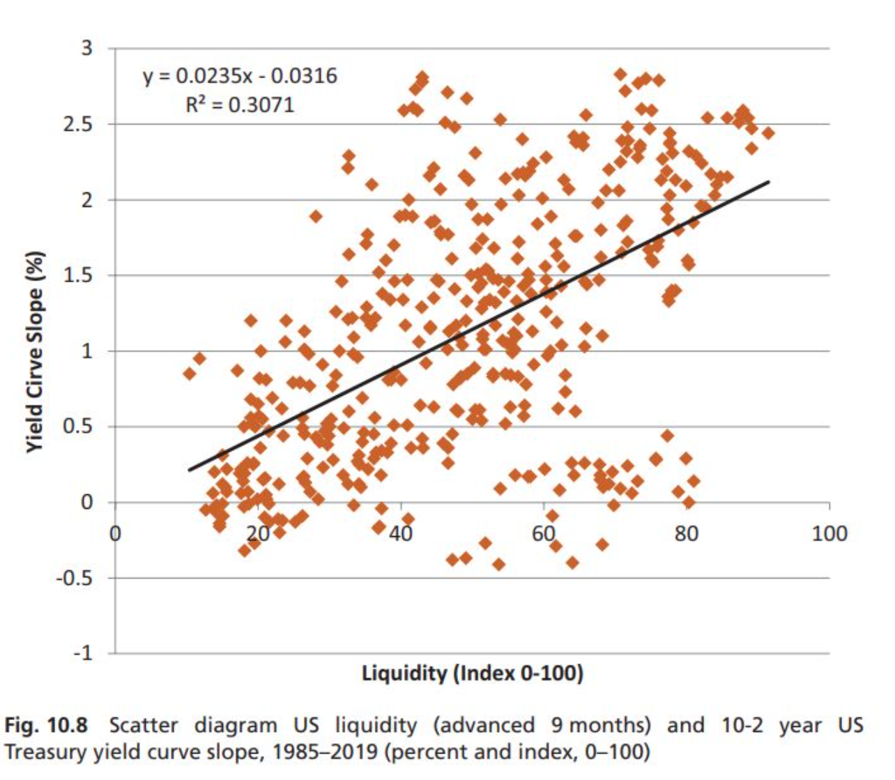
The problem with simple models in finance

Slide 3
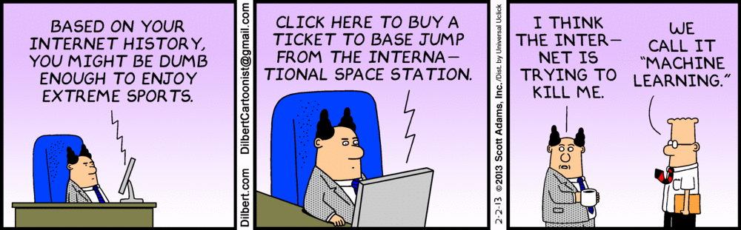
What is machine learning?
[http://dilbert.com/strip/2013-02-02]

Slide 4
A formal definition of machine learning
“A computer program is said to learn from experience E with respect to some class of tasks T and performance measure P, if its performance at tasks in T, as measured by P, improves with experience E.”
For example, learn to play checkers
T: play checkers
P: % of games won in world tournament
E: opportunity to play against self
[“Machine Learning,” T. Mitchell, 1997]

Slide 5
Artificial intelligence, machine learning and data mining
Artificial intelligence: intelligence exhibited by machines
Artificial general intelligence (AGI): intelligence of a machine that could successfully perform any intellectual task that a human being can
Strong AI
Applied AI: the use of software to study or accomplish specific problem solving or reasoning tasks
Weak AI
Data mining: the process of discovering patterns: automatically or semi-automatically, in large quantities of data
AI
Machine Learning
Data mining
Very crude conceptual distinction of AI, machine learning and data mining

Slide 6
Machine learning: a general view
A general view of the data we collected for machine learning
The physical world process can be anything of interests
Social behavior
Human’s state of mind while speaking
Natural phenomena (tree growing, mushroom types, etc.)
The physical world process can be time varying as well
Most of the problems we deal with in this course do NOT consider the time varying effects
Not all inputs and outputs are observable
We collect a subset of observable data with repeated “experience”
A physical world process
Inputs
Outputs
Observable data

Slide 7
Machine learning challenges
Complexity: The physical world process can be
Unknown (e.g., human social behaviors, stock buying and selling)
Known, but too complicated to simulate most of the time (e.g., semiconductor physics, weather and other chaotic systems)
Directionality: When we put the collected observable data together, we don’t necessarily know what data are inputs and what data are outputs
Causality: But we typically know what interested data to predict, i.e., what class of tasks to perform, based on what observable data
The data to be predicated and the observable data do NOT necessarily have any causal effects
“The fire emergence” vs “The alarming sounds of fire engines”
Value: Machine learning is to provide that bridge as a surrogate model (in part) of the physical world process and may not provide value in either understanding, predicting, or controlling the process

Slide 8
Machine learning models
Though ML models do not necessarily depend on the knowledge about the physical world process, imparting such knowledge to the design of ML model will definitely help and tells us whether the model has value once produced
A physical world process
Inputs
Outputs
Observable data
Experimental Design
Machine Learning
Machine Learning Models
A subset of observable data
Predicted data of interests

Slide 9
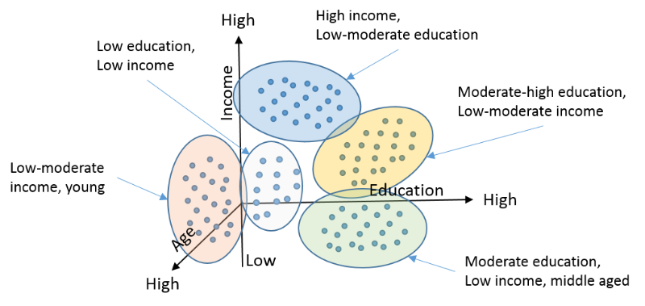
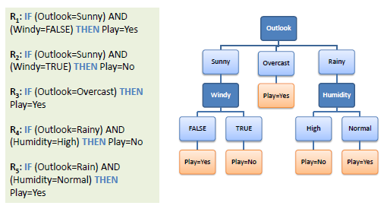

What does a machine learning model look like?
Model can be considered as a way to represent “knowledge” in some structural form
A functional form
The functional form itself can sometimes be represented as a network or graphical form
A cluster form that partitions data
A set of decision rules
$$y=f(x)$$

Slide 10
Machine learning touch points
End users: use the ML application developed by someone else with your application data
Know how to interpret ML results, and communicate with your peers/bosses
Application developers: use existing ML packages and develop your own applications
Know how to select models (pros and cons) and how to train models with your data by using existing ML packages
Model developers: modify existing models or suggest new models based on application knowledge (more mathematic background)
Use existing ML packages to incorporate new models
Algorithm developers: create faster and better ways of training ML models (more computer science background)
Implement the algorithm in existing software packages or develop new ones

Slide 11
Drivers of ML applications
Big data
Volume
Velocity
Variability
Need for automation to handle big data
Build off experience of SMEs
Competitive pressures
Increased expectations

Slide 12
Classes of ML algorithms
Supervised learning
Unsupervised learning
Reinforcement learning
Ensemble modeling
Weak supervision
Generative Adversarial Networks
Transfer learning
Time series analysis

Slide 13
Challenges using Financial Data
Highly competitive use of data
Model training with insufficient data
Competition versus sophisticated opponents
Often a zero sum game
Generating profits in an efficient markets
Better algorithms
Faster hardware
Alternative data sources
Insider information
Risk management
Interpretability
Limited shelf life of algorithms
Notes:
Be better
Cheat
Be First

Slide 14
Machine Learning challenges on financial markets/data
The range of potential financial models
Aligning modeling goals with financial objectives
Understanding the mathematical limitations
Data and subject expertise
Data needs for model training
Degree of consensus on ground truth
Implementation
Programming resources
Monitoring algorithm performance over time
Data drift
Specification changes over time

Slide 15


Data: $𝒟=\left(X,Y\right)$
$X=\left(\begin{matrix}x_{1}^{\left(1\right)} & ⋯ & x_{1}^{\left(d\right)} \\ ⋮ & ⋱ & ⋮ \\ x_{N}^{\left(1\right)} & ⋯ & x_{N}^{\left(d\right)}\end{matrix}\right)$
$Y=\left(\begin{matrix}y_{1} \\ ⋮ \\ y_{N}\end{matrix}\right)$

Slide 16
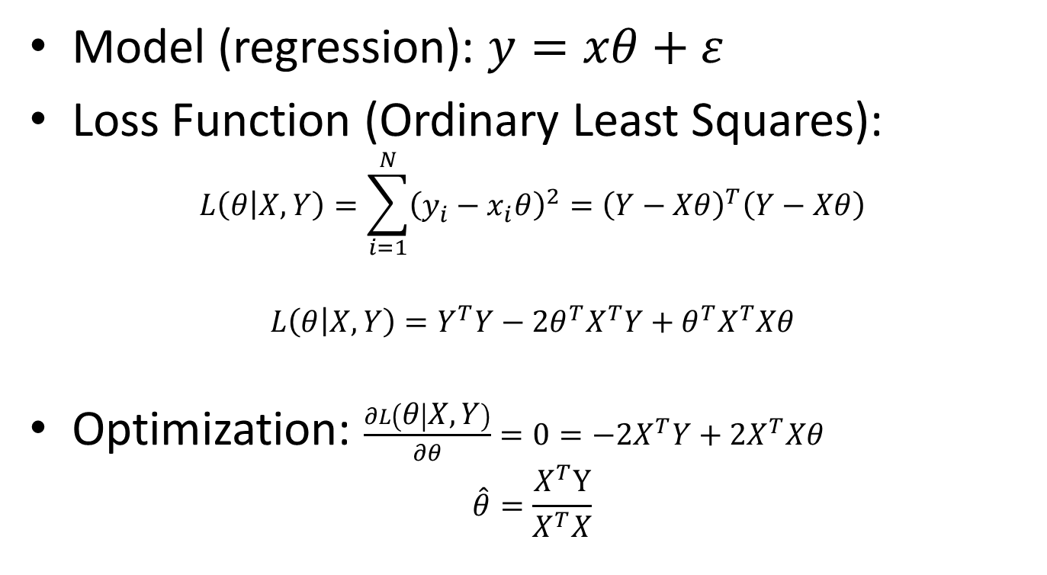
A simple model: OLS regression
Model (regression): $y=xθ+ε$
Loss Function (Ordinary Least Squares):
$$L\left(θ | X,Y\right)=\sum_{i=1}^{N}{{\left(y_{i}−x_{i}θ\right)}^{2}={\left(Y−Xθ\right)}^{T}\left(Y−Xθ\right)}$$
$$L\left(θ | X,Y\right)=Y^{T}Y−2{θ^{T}X}^{T}Y+{θ^{T}X}^{T}Xθ$$
Optimization: $\frac{∂L\left(θ | X,Y\right)}{∂θ}=0=−2X^{T}Y+2X^{T}Xθ$
$$\hat{θ}=\frac{X^{T}Y}{X^{T}X}$$

Slide 17
Assignment: tools needed for class
Google Colab account
Import code into your Colab account from https://github.com/deepintomlf/mlfbook.git
Install python packages including
Pandas
Numpy
Keras and Tensorflow
A local installation of Anaconda and Jupyter notebook
Read Chapter 1 in “An introduction to machine learning in quantitative finance”

Slide 18


Slide 19


Slide 20


